Slide 1
Back to Basics:
IPAC Considerations in Vascular Access
Madeleine Ashcroft, RN, MHS, CIC, CVAA (c)​
12 December 2023

Slide 2
Introduction
ICPs and Vascular Access Nurses have different roles and specialty knowledge, but we share concerns with preventing intravascular infections
Today’s session is a review of basic IPAC principles as they relate to intravascular therapy

Slide 3
Objectives
By the end of this session, in relation to blood stream infections, you will be able to:
Describe the importance of prevention
List common organisms
Recognize key risk factors
Note signs and symptoms
Highlight key preventative strategies

Slide 4
Impact of catheter-related bloodstream infections
Nearly 40% of healthcare-associated bacteraemia
Especially short-term non-cuffed single or multiple lumen in internal jugular
Peripheral IVs - low incidence of infection but most frequently used
More IV lines in non-acute settings – including in the home
Increasingly vulnerable and fragile patients
Increasingly invasive
90% of catheter related blood stream infections (CR-BSIs) occur with Central Vascular Catheters (CVCs)
55% ICU patients and 29% non-ICU patients have CVCs
Up to 70% of hospitalized patients with CVCs outside ICU
Gaynes, R., & Jacob, J. T. (2019). Intravascular catheter-related infection: Epidemiology, pathogenesis, and microbiology – UpToDate
Haddadin, Y., Annamaraju, P., & Regunath, H. (2017).. Central Line Associated Blood Stream Infections - Abstract - Europe PMC
Image source: PickPik

Slide 5
Cost of BSIs
Estimated 40,000 – 49,000 episodes per year in Canada
7,000 – 9,000 deaths
Among top 7 causes of death
Central line–associated bloodstream infections (CLABSIs):
Significant morbidity, mortality, and healthcare costs
Mortality estimated to be over 40% - one of the deadliest HAIs
May lead to 3 weeks of increased length of stay and up to $56,000 USD of excess healthcare cost for each CLABSI event
Canadian data: device-associated infections, including central lines (CLs) = 35.6% of all HAIs and CLABSIs make up 21.2% of these
2009 - 2018: 2973 CLABSIs, most in adult and neonatal ICUs.
Within 30 days of first positive culture, 32.3% of adult CLABSIs and 8% of neonatal ICU CLABSI cases had died
Goto & Al-Hasan (2013). Overall burden of bloodstream infection and nosocomial bloodstream infection in North America and Europe – ScienceDirect
Redstone, Zadeh, Wilson, et al. (2023). A Quality Improvement Initiative to Decrease Central Line–Associated Bloodstream Infections During the COVID-19 Pandemic: A “Zero Harm” Approach - PMC (nih.gov)
CNISP (2020) Device-associated infections in Canadian acute-care hospitals from 2009 to 2018 – ProQuest
Notes:
Estimated 40 000–49 000 episodes in Canada Resulting in 7000–9000 deaths
Substantial differences in estimates of nosocomial BSI between population-based and nosocomial infection surveillance data. Among the top seven causes of death in all included countries in North America and Europe
Difficult to obtain precise estimates of nosocomial BSI, owing to the limited number of studies. This review highlights the need for a greater focus on BSI research in order to reduce the overall burden of disease by improving the outcome of patients with BSI. It also emphasizes the role of infection control and prevention methods in reducing the burden of nosocomial BSI Goto, M., & Al-Hasan, M. N. (2013). Overall burden of bloodstream infection and nosocomial bloodstream infection in North America and Europe. Clinical Microbiology and Infection, 19(6), 501-509.
Central line–associated bloodstream infections (CLABSIs) are associated with significant morbidity, mortality, and healthcare costs.1 Mortality from CLABSIs is estimated to be an upward of 40%, making them one of the deadliest healthcare-associated infections.2 Central line–associated bloodstream infections may also lead to 3 weeks of increased length of stay and up to $56,000 USD of excess healthcare cost for each CLABSI event.2
Canadian data from 10 provinces reveal that device-associated infections, including central lines (CLs), account for 35.6% of all healthcare-associated infections, and CLABSIs make up 21.2% of these.3 Another study reported that between 2009 and 2018, there were 2973 cases of CLABSIs, most of which occurred in adult intensive care units (ICUs) and neonatal ICUs. Within 30 days of first positive culture, 32.3% of adult CLABSIs and 8% of neonatal ICU CLABSI cases had died.4 Overall CLABSI rates in adult ICUs in Canada are similar to the rates reported in the United States and in Australia. However, higher rates have been reported in other areas, including Europe, Latin America, and Southeast Asia.5

Slide 6
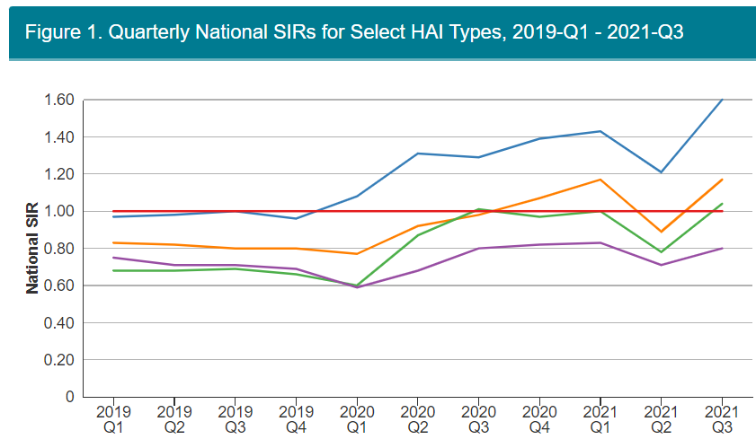
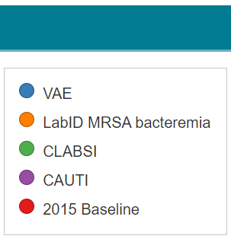
Increased CLABSI Rates during COVID-19 pandemic
CLABSI rates increased by 51% during the first 6 months of the pandemic… and this continued in 2021
6. Fakih, Bufalino, Sturm, Huang, et al. (2022). Coronavirus disease 2019 (COVID-19) pandemic, central-line–associated bloodstream infection (CLABSI), and catheter-associated urinary tract infection (CAUTI): The urgent need to refocus on hardwiring prevention efforts - PMC (nih.gov)
Notes:
One study reported a 51% increased rate of CLABSIs during the pandemic period, and the rates of CLABSIs in COVID patients specifically were 5 times greater than non-COVID hospitalized patients.12 Another study of more than 900 facilities in the United States reported a 28% increase in a standardized infection ratio for CLABSIs.13

Slide 7
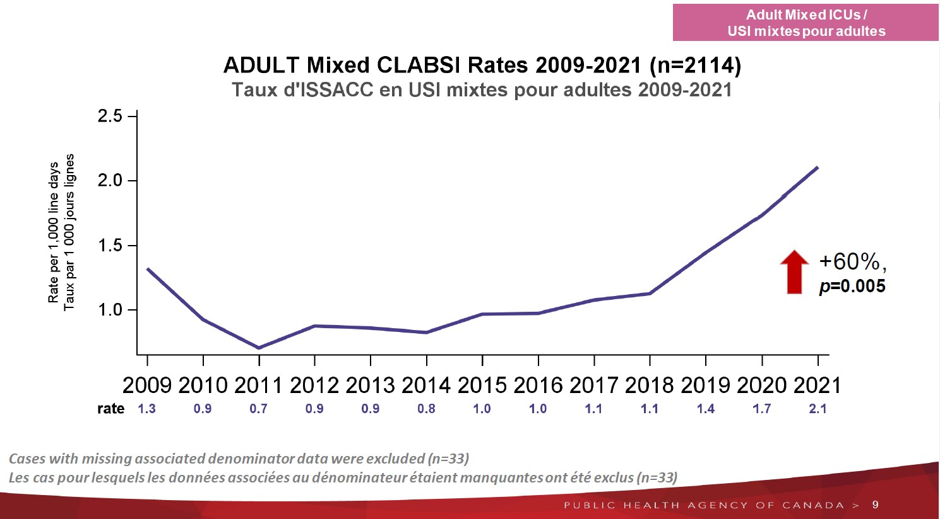
Canadian Data
Canadian Nosocomial Infection Surveillance Program (CNISP)
7. CNISP (2022) Device and surgical procedure-related infections in Canadian acute care hospitals from 2011 to 2020 - PubMed (nih.gov)
Notes:
First graph indicates the rate of clabsi/1000 catheter days, in 2021, the rate reached 2.1

Slide 8
Canadian Data – Organisms
7. CNISP (2022) Device and surgical procedure-related infections in Canadian acute care hospitals from 2011 to 2020 - PubMed (nih.gov)
Notes:
Note mostly CONS - blue, then enterococcus - green – increasing, then Candida albicans - red

Slide 9
Most Common Pathogens in BSIs
Organism | % of VADA BSI
Gram Positive
Coagulase-negative staphylococci | 16.4%
Enterococcus (faecalis, faecium, other) | 17.2% (17% VRE in Canada)*
Staphylococcus aureus | 13.2% (13% MRSA in Canada)*
Gram Negative
Klebsiella | 8.4%
Escherichia coli | 5.4%
Enterobacter | 4.4%
Pseudomonas aeruginosa | 4.0%
Proteus, Bacteroides | 1.3%
Candida albicans | 6.0%
Candida Species | 4.9%
Other Pathogens | 14.6%
Canada 2021:
23.4%
25.4%
8%
Antimicrobial-Resistant Pathogens Associated With Healthcare-Associated Infections: Summary of Data Reported to the National Healthcare Safety Network at the Centers for Disease Control and Prevention, 2011–2014 | Infection Control & Hospital Epidemiology | Cambridge Core
* Device-associated infections in Canadian acute care hospitals from 2009 to 2018, CCDR 46(11/12) - Canada.ca
Notes:
Historically, as you can see, coag.-negative staph, a common skin commensal, is by far the biggest culprit, followed by various enterococci, and Staph. aureus, enteric gram-negative bacilli, Pseudomonas, Candida, and others.
This is also something to consider when looking at blood culture results – skin organisms are the most likely organisms to be found – both because of infection and contamination!
Note 13% of the Staph aureus was MRSA and 17% of the enterococcus was VRE in Canada from 2009-2018.
If we compare the 2021 organisms from the previous slide, we can see an increase in CON staff, enterococcus, and candida.
From the current APIC Text: Cdn data align e.g., CNISP 2009 to 2018 -
Device-associated infections in Canadian acute care hospitals from 2009 to 2018, CCDR 46(11/12) - Canada.ca

Slide 10
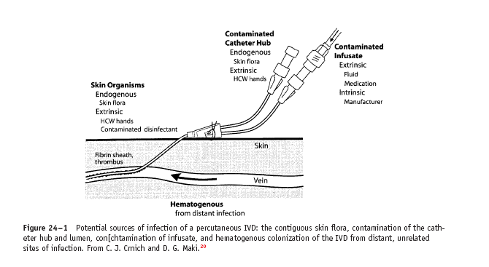
Pathogenesis
Migration of skin organisms
Hub contamination
Hematogenous seeding
Infusate contamination (rare)
Crnich C, Maki D., 2009⁹
Notes:
Migration: 1st (short term) Then Hub (>10 days)
Infusate – us. Gm. Neg. bacilli

Slide 11
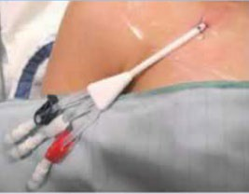
Risk Factors for BSI
Having an intravascular catheter, especially a central line
Being in ICU or having hemodialysis (HD), surgery or oncology treatment
Previous use of antibiotics
For secondary bacteremia – UTI and IV catheter
9. A two-year analysis of risk factors and outcome in patients with bloodstream infection - PubMed (nih.gov)
Image source: Pinterest
Notes:
A two-year analysis of risk factors and outcome in patients with bloodstream infection - PubMed (nih.gov)
The most frequent predisposing factors for BSI were intravascular catheter (56.4%) and previous use of antibiotics (50.9%). Infections were considered as primary in 67.9% of cases. Urinary tract and intravascular catheter were the most frequent source of secondary bacteremia (43.1% and 35.9%, respectively).
Note: The most frequent predisposing factors for BSI were intravascular catheter (56.4%) and previous use of antibiotics (50.9%). Infections were considered as primary in 67.9% of cases. Urinary tract and intravascular catheter were the most frequent source of secondary bacteremia (43.1% and 35.9%, respectively).

Slide 12
Independent Risk Factors
Prolonged hospitalization before catheterization
Prolonged duration of catheterization
Heavy microbial colonization at insertion site or catheter hub
Multi-lumen catheters
Concurrent catheters
Neutropenia
Body mass index (BMI) >40
Prematurity (i.e., early gestational age)
Reduced nurse-to-patient ratio in the ICU
Parenteral nutrition
Substandard catheter care (e.g., excessive manipulation of the catheter)
l.
Transfusion of blood products (in children)
10. SHEA-IDSA-APIC. (2022). Strategies to prevent central line-associated bloodstream infections in acute-care hospitals: 2022 Update | Infection Control & Hospital Epidemiology | Cambridge Core
Notes:
2022 SHEA-IDSA-APIC Practice Recommendations also note that having Independent factors include” Prolonged hospitalization before catheterization
Prolonged duration of catheterization
Heavy microbial colonization at insertion site Or the catheter hub e. Multilumen catheters Concurrent catheters
Neutropenia
Body mass index (BMI) >40 i. Prematurity (ie, early gestational age) Reduced nurse-to-patient ratio in the ICU
Parenteral nutrition
Substandard catheter care (eg, excessive manipulation of the catheter) Transfusion of blood products (in children)

Slide 13
Risk Factors – General Patient-related
Also consider the susceptible host:
Age (< 1 year or > 60 years)
Loss of skin integrity (burns)
Chemo or radiotherapy
Distant focus of infection
Severity of underlying illness
Notes:
Read slide.

Slide 14
Risk Factors – Catheter/Device-related
Procedure: Difficult insertion
Type of catheter material
Frequency of surface irregularities
Thrombogenicity of catheter material
Antibiotic or antiseptic impregnated catheters
Notes:
Teflon & polyurethane have fewer complications.
PVC or polyethylene less resistant to adherence of microorganisms than Teflon, silicone elastomer, or polypropylene. Surface irregularities: enhance adhesion especially coag. Neg. staph, acinetobacter calcoaceticus, Pseudomonas aeroginosa Thrombogenic: More clots = more potential for infection
Novel technologies:
1. Chlorhexidine/silver sulphadiazine: ext. lumen: 14 days
Int. & ext. consider for certain patients (ICU, burn, neutropenic, or rate>3.3/1000 device days
Minocycline/Rifampin - ?increase resistance – consider after routine precautions Platinum/silver – insufficient Studies
Silver cuffs: insufficient studies

Slide 15
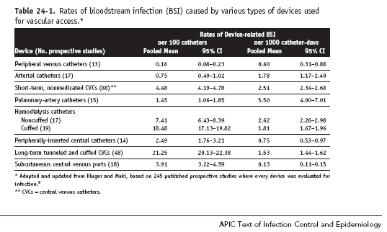
BSI Rates related to type of device
From Crnich CJ, Maki DG., 2009¹
Notes:
Note differences in numbers for per 100 catheters versus per 1000 catheter days –
Per 100 catheters does not factor in duration insitu – so long-term catheters appear worse.
PA catheters and Non-cuffed HD catheters highest
Types of Lines:
Peripheral venous or arterial catheters (<7.5 cm)
Midline catheters (7.5 – 25 cm)
CVCs – non-tunneled (no cuffs) and tunneled (with a dacron cuff)
Totally implantable devices – subcutaneous ports - BEST

Slide 16
Microbe-related factors
Adherence properties
Formation of biofilms
Increasing presence of yeast
Notes:
Adherence: S. aureus can adhere to host proteins (e.g., fibronectin) on caths.
Coag. Neg. Staph adhere to polymer surfaces more readily than other (E. coli, S. aureus)
Biofilms: some coag. Neg strains produce extra polysaccharides or ‘slime’ which potentiates pathogenicity (can withstand host defenses and antibiotics Some Candida strains can produce slime too.

Slide 17
Host-microbe-device Risk Factors
Type of placement (cutdown>percutaneous)
Emergent placement>elective
Dense cutaneous colonization at entry site
Dressing material (gauze versus transparent)
Skill of practitioner inserting
Type of skin antiseptic (CHG>PI)
Use of topical antimicrobial ointment
Frequency of entry into system
(HD)
Notes:
Gauze vs Transparent:
Transparent- more visual, less changes
Overall equivocal, except for arterial catheters (inc. risk) Chlorhexidine 2% in 70% isopropyl alcohol
0.5% in neonates
Biopatch sponge (Chlorhexidine) – reduced BSI by 60% but dermatotoxicity in LBW infants Also: Securement – done study – device better than sutures (festering)

Slide 18
Definition of a catheter-related bloodstream infection
“The presence of bacteremia originating from an intravenous catheter”
Blood cultures help to identify the source
Notes:
So how do we diagnose a CRBSI?

Slide 19
Classification of catheter-related bacterium (CRB)
DEFINITE CRB Colonized catheter Bacteremia with same organism Organism not identified at any other site that is a probable source | PROBABLE CRB, TYPE 1 Colonized catheter Bacteremia with same organism Catheter the most likely source although Same organism identified and colonizing other site
PROBABLE CRB, TYPE 2 Colonized catheter Clinical manifestations of sepsis Defervescence after removal of implicated catheter but No lab confirmation of bacterium | POSSIBLE CRB Bacterium Clinical manifestations of sepsis Defervescence after removal of implicated catheter but No lab confirmation of CVC colonization
11. Fraenkel DJ, Rickard C, Lipman J, 2000: Can we achieve consensus on central venous catheter-related infections? - PubMed (nih.gov)
Notes:
There are more than one classification systems for bacteremias in relation to catheter organisms. Here is one commonly used.

Slide 20
Definitions of a CLABSI – Surveillance definition
Primary Bacteremia:
1 positive blood culture with a recognized pathogen AND No other site of infection
Secondary Bacteremia:
1 positive blood culture with a recognized pathogen AND
Infection at another site with the same organism at same time or within 3 days prior
Likely NOT a contaminant if:
2 or more positive blood cultures with a skin organism AND Sampled at different sites or different moments
12. Hall & Layman (2006): Updated Review of Blood Culture Contamination - PMC (nih.gov)
Notes:
Staph epi cause 70 -80% of contaminated cultures
even though only 12.4% of coagulase-negative staphylococcal isolates were clinically significant, they ranked as the third most common cause of bacteremia because of their high prevalence Other studies found rates of true bacteremias ranging from 10% to 26.4% when coagulase-negative staphylococci are isolated from blood cultures
In one modeling study of patients with a central vascular line and a positive culture for coagulase-negative staphylococci, the positive predictive value was 55% when one of one culture was positive, 20% when one of two cultures was positive, and only 5% when one of three cultures was positive (139).
In the face of such data, it has become increasingly clear that maximizing the diagnostic utility of blood cultures requires at least two sets be performed. Look at antimicrobial susceptibility patterns and time to positivity – more than 3-5 days incubation – likely contaminant.
Also quantity of growth and clinical symptoms

Slide 21
Blood culture requirements
Quantitative paired blood cultures (same time) - peripheral and from CVAD
Ratio >5:1
Access to time-to-positivity
Sample from CVAD positive at least 2 hours before peripheral sample

Slide 22
Clinical signs and symptoms of infection
Non-Specific | Suggestive of Device-related Etiology
Fever - chills, shaking rigors, Hypotension, shock Hyperventilation, respiratory failure | Unlikely candidate No identifiable local infection
Gastrointestinal Abdominal pain Vomiting Diarrhea | Intravascular line in place, especially central Inflammation or purulence at site Abrupt onset
Neurologic
Confusion, Seizures | Septicemia with staphyloccocci, candidemia, infusion-associated related organisms Unresponsive to antimicrobial therapy

Slide 23
Algorithm for Diagnosis & Management of CR-BSI
Examine Patient for Other/
Unrelated Sources
of Infection
If peripheral or arterial
- Remove & Culture Catheter
If central
- Decide with Physician
according to organisms
Check All IV Insertion Sites
- Culture Any Purulent
Blood Cultures
– Peripheral and via Line
Consider salvage with antimicrobial locks for central lines
Notes:
Can remove if wish
Also:
Culture brush (endoluminal)
Quantitative skin-swab cultures of insertion site (short term CVCs)
Differential time to positivity
Gm. Stain or acridine orange staining of blood from IVD
5 to 10 fold higher from device = IVD BSI
(Only 15 - 45% of all LT IVDs removed for suspect infection are truly colonized or infected.)
Salvage with antimicrobial locks is increasingly frequent and effective

Slide 24
Strategies to Prevent CRI
Health care worker (HCW) education & training
Hand hygiene
Surveillance and Benchmarking
Needs assessment
Catheter anatomy – device, insertion, site care, catheter care, delivery system
Notes:
Needs assessment:
Catheter with lowest risk – do they really need a PA line? Sandham et al NEJM 2003 – no benefit on survival Prompt removal
No routine replacement
Q72-96 hr. replacement of peripheral
No guideline replacement

Slide 25
Patient Safety Campaigns
Original ‘100K lives’ Campaign (2004) became ‘Protecting 5 Million Lives from harm’ (2006)
Institute for Healthcare Improvement
How-to Guide: Prevent Central Line-Associated Bloodstream Infections - 12 hospitals had gone 12 months without a single CR-BSI!
Ongoing free webinars
Notes:
Historically, the big surge to reduce HAIs began in 2004 in the US with the 100K Lives campaign http://www.ihi.org/IHI/Programs/Campaign/
IHI CEO, Don Berwick
In Canada, – followed by the Canadian Safer Health Care Now! initiative in 2014, by the CPSI.

Slide 26
Don Berwick (2004):
"The names of the patients whose lives we save can never be known. Our contribution will be what did not happen to them. And, though they are unknown, we will know that mothers and fathers are at graduations and weddings they would have missed, and that grandchildren will know grandparents they might never have known, and holidays will be taken, and work completed, and books read, and symphonies heard, and gardens tended that, without our work, would never have been.“

Slide 27
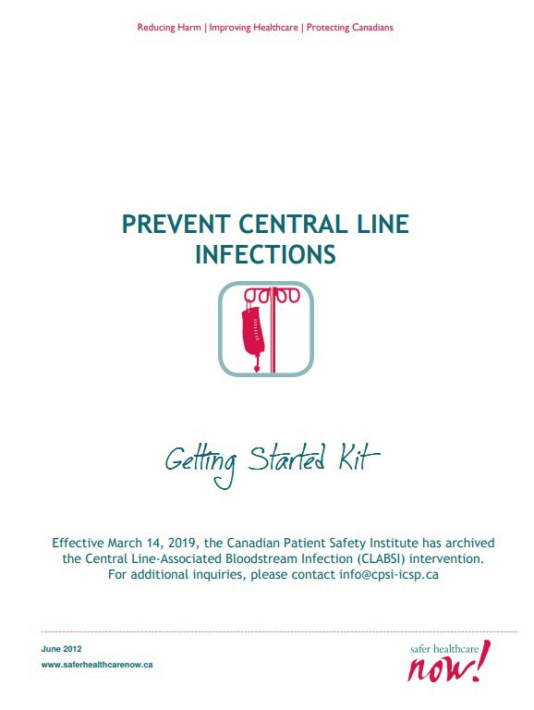
Safer Healthcare Now!/Quebec Campaign: Together, let's improve healthcare safety!
In Canada - Safer Healthcare Now! Canadian Patient Safety Institute (2014) - Originally 6 targeted strategies – then 10 4 are infection control, including
Prevention of Central Line-Associated Bloodstream Infection
Canadian Foundation for Healthcare Improvement and the Canadian Patient Safety Institute are now amalgamated as a new organization, Healthcare Excellence Canada
2 bundles: insertion & care
Care bundle now includes dressings and arterial lines,
and use of ultrasound
Microsoft Word - CLI_GSK EN Mar2012 v4.docx (patientsafetyinstitute.ca)

Slide 28
Essential Components of ‘Bundles’
Hand hygiene
Maximal barriers – Cap, mask, sterile gown & gloves; full sterile drape
Skin antisepsis – chlorhexidine in alcohol
Optimal site selection – subclavian in ICU
Daily review of necessity
Aseptic lumen access
Catheter site and tubing care
Image source: Public Health Ontario
Notes:
Current with 2022 recommendations – separate lumen for TPN removed and Monitor insertion site with dressing changes (moved into catheter site and tubing care)

Slide 29
Sterile or Antiseptic?
Sterile: free from bacteria or other living microorganisms (Oxford Languages and Google - English | Oxford Languages (oup.com))
Aseptic: Preventing infection; free or freed from pathogenic microorganisms (https://www.merriam-webster.com/dictionary/aseptic)
Aseptic Technique: Strict procedures to prevent any organisms from entering and causing infection
Aseptic Non Touch Technique (ANTT®): An international clinical practice framework originated by Rowley for a technique for all clinically invasive procedures, that maintains asepsis and is non- touch in nature
Notes:
We prefer to use the ANTT framework and terminology

Slide 30
Aseptic Non Touch Technique (ANTT®)
Developed to define:
“Key-Part (part of procedure equipment that if contaminated is likely to contaminate the patient, e.g., IV cannula tip) and
“Key-Site” (any portal of entry, e.g., VAD site) Protection” and
Detailed terminology (e.g., general, critical, and micro critical aseptic field)⁴
Standard-ANTT:
A combination of Routine Practices using non-touch technique and Micro Critical Aseptic Field to protect Key-Parts and Key-Sites
For straightforward and short duration clinical procedures (e.g., VAD flushing and locking)
If Key-Parts and Key-Sites require direct touch, sterile gloves must be used
Surgical-ANTT:
A combination of Routine Practices using a sterile drape(s) and barrier precautions to protect Key-Parts and Key-Sites for difficult and/or long duration invasive clinical procedures (e.g., surgery and central line insertion)

Slide 31
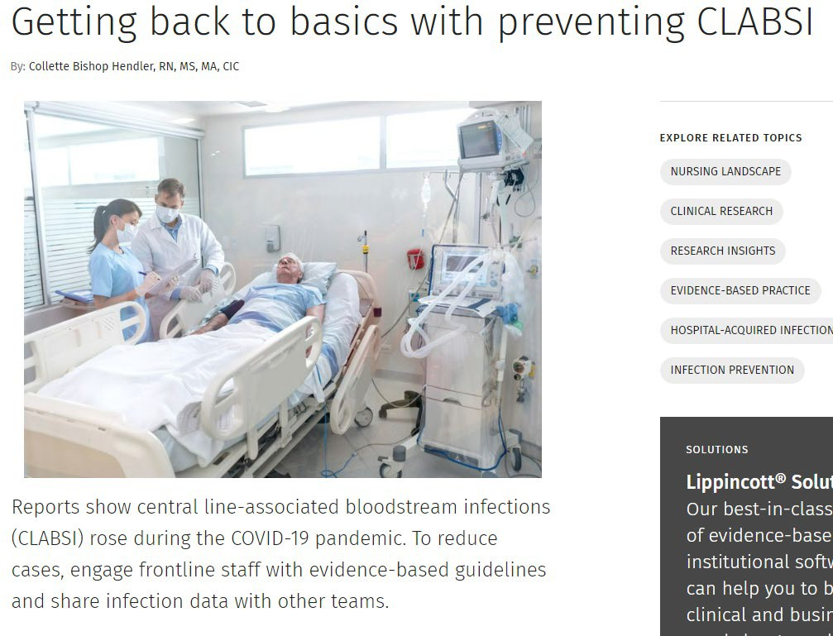
What now?
Back to basics
Hand hygiene
Change of dressing when needed
Removal of line as soon as possible
Maintain patency
Scrub the hub (or have it done)
Usage of CVAD for blood
Antibiotic usage
Hendler (2022). Getting back to basics with preventing CLABSI | Wolters Kluwer
Notes:
CD007798.pdf (nih.gov) Clinically-indicated replacement versus routine replacement of peripheral venous catheters (Review) – no evidence to support routine PIV site change
CDC – 2019: US Centers for Disease Control guidelines recommend replacement of peripheral intravenous catheters (PIVC) no more frequently than every 72 to 96 hours. Routine replacement is thought to reduce the risk of phlebitis and bloodstream infection Clinically‐indicated replacement versus routine replacement of peripheral venous catheters - PMC (nih.gov)

Slide 32
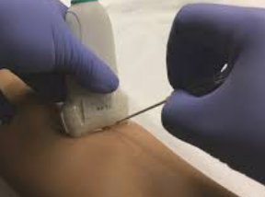
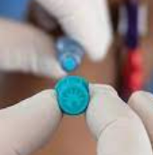
SHEA/IDSA/APIC Practice Recommendation – Strategies to prevent central-line associated blood stream infections in acute-care hospitals: 2022 Update
« Essential practices » - use:
Subclavian vein
Ultrasound guidance
Chlorhexidine dressings
Tubing replacement up to 7 days
« Additional Approaches »
Antimicrobial ointment for HD catheter site
Antiseptic caps
Importance of infusion teams
Sutureless securement
Image sources: researchgate.net and BD
Notes:
Essential practices replace “basic principles” to stress foundational
Antiseptic caps not considered superior to manual disinfection as essential practice

Slide 33
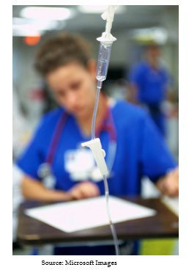
SHEA update 2022 – Essential practices
Before insertion
Minimize unnecessary placement
Education and competency assessement
Daily CHG bathing (>2 mo)
Hand hygiene
At insertion
Use checklist
HH prior to catheter insertion/manipulation
Use subclavian as preferred insertion site in ICU
Use all inclusive cart/kit
Ultrasound guidance for insertion
Maximum sterile barrier precautions
CHG 2% in alcohol for skin prep
Level of evidence:
LOW MODERATE HIGH
Notes:
Essential Practices – colour-coded by level of evidence Hand hygiene before insertion & manipulation

Slide 34
SHEA update 2022 – Essential practices
After insertion
Appropriate nurse to patient ratio & limit float nurses in ICU
CHG dressing (>2 mo)
Change transparent dressing and perform site care (with CHG) at least q 7 days or when soiled, loose, damp;
Change gauze dressing q 2 days or earlier
Disinfect catheter hub/needleless connectors before accessing
Remove non-essential catheters
Replace administration set at intervals up to 7 days
Level of evidence:
LOW MODERATE HIGH
Perform CLABSI surveillance (ICU and non-ICU)
Notes:
Monitor compliance with hub-connector-port disinfection because approximately half of such catheter components are colonized under conditions of standard practice. 152,156,158

Slide 35
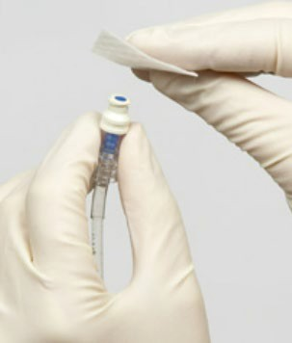
Disinfecting solution- Chlorhexidine
Skin prep: Chlorhexidine in alcohol for >2 months of age
2% in 70% isopropyl alcohol - back and forth friction scrub for at least 30 seconds
Do not wipe or blot - Allow to dry completely (≈ 2 minutes)
Allergies: 10% Povidone-iodine in alcohol or alcohol
Scrub the hub/Sampling:
Chlorhexidine in alcohol/antiseptic containing caps
Before accessing hubs, needleless connectors, or injection ports, vigorously apply mechanical friction with alcoholic chlorhexidine or 70% alcohol. Alcoholic chlorhexidine preferred for additional residual activity
Apply mechanical friction for a minimum of 5 seconds to reduce contamination
Monitor compliance as ≅ 50% are colonized
Image sources: deltamed.pro and
psqh.com
Notes:
Chlorhexidine is best
Metanalysis - 50% reduction vs Poviodine
Prepare skin with Chlorhexidine 2% in 70% isopropyl alcohol Apply using a back and forth friction scrub for at least 30 seconds Do not wipe or blot
Allow to dry completely (≈ 2 minutes)
If contraindication to chlorhexidine, tincture of iodine, an iodophor, or 70% alcohol can be used as alternatives
Monitor compliance with hub-connector-port disinfection because approximately half of such catheter components are colonized under conditions of standard practice Chlorhexidine versus povidone-iodine for central venous catheter site care in children - PubMed (nih.gov)
Skin antisepsis for reducing central venous catheter-related infections - PubMed (nih.gov) (Cochrane Review) CDC: Microsoft Word - CLI_GSK EN Mar2012 v4.docx (patientsafetyinstitute.ca)
Chlorhexidine is used in oral treatments/mouth washes to good effect
Comparison of Efficacy of 2% Chlorhexidine Gluconate–Alcohol and 10% Povidone-Iodine–Alcohol against Catheter-Related Bloodstream Infections and Bacterial Colonization at Central Venous Catheter Insertion Sites: A Prospective, Single-Center, Open-Label, Crossover Study - PMC (nih.gov)

Slide 36
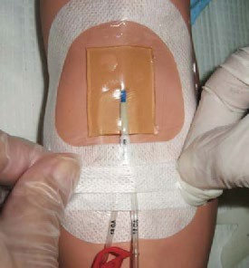
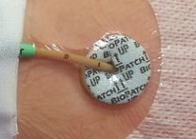
CHG patch or Tegaderm CHG
Easy to remove
Dressing takes longer to make
Covers skin all around insertion site
Site not visible
Must be applied on the right side
Provides additional securement
Easy to change dressing
Must be changed timely if patch becomes saturated (erosive dermatitis)
https://commons.wikimedia.org/wiki/File:PICC_oml%C3%A4ggning.jpg
Use of a 1-piece chlorhexidine gluconate transparent dressing on critically ill patients. | Semantic Scholar

Slide 37
SHEA update 2022 – Additional approaches
Antiseptic or antimicrobial-impregnated CVC (adult* – peds)
Antimicrobial lock therapy for long-term CVC**
Rt-PA once weekly for hemodialysis patients with a CVC
Use infusion or vascular access team to reduce CLABSI rates
Antimicrobial ointment for HD catheter insertion sites
Use antiseptic-containing hub/connector cap/port protector to cover connectors
Level of evidence:
LOW MODERATE HIGH
Notes:
Antiseptic/antimicrobial impregnated catheters if CLABSI rates above goals, limited venous access and history of recurrent CLABSI, and those at heightened risk of severe sequelae from a CLABSI (eg, patients with recently implanted intravascular devices such as a prosthetic heart valve or aortic graft Consider antimicrobial stewardship and the potential for resistance with antimicrobial locks – they are recommended for
Patients with long-term hemodialysis catheters who have a history of recurrent CLABSI, limited access, history, or risk of poor outcomes
Use recombinant tissue plasminogen activating factor (rt-PA) once weekly after hemodialysis in patients undergoing hemodialysis through a CVC Utilize infusion or vascular access teams for reducing CLABSI rates
Use antimicrobial ointments for hemodialysis catheter insertion sites

Slide 38
SHEA update 2022 – Don’ts
Do not use antimicrobial prophylaxis for short-term or tunneled catheter insertion or while catheters are in situ
Do not routinely replace CVCs or arterial catheters

Slide 39
SHEA update 2022 – Unresolved
Routine use of needleless connectors as a CLABSI prevention strategy before an assessment of risks, benefits, and education regarding proper use
Surveillance of other types of catheters (e.g., peripheral arterial or venous catheters)
Standard, nonantimicrobial transparent dressings and CLABSI risk
The impact of using chlorhexidine-based products on bacterial resistance to chlorhexidine
Sutureless securement
Impact of silver zeolite-impregnated umbilical catheters in preterm infants (applicable in countries where it is approved for use in children)
Necessity of mechanical disinfection of a catheter hub, needleless connector, and injection port before accessing the catheter when antiseptic-containing caps are being used.
Notes:
Needleless adapters help prevent needlestick injuries but may increase infection risk – e.g., stopcocks Wording supports consideration of surveillance for all catheters
Standard, nonantimicrobial transparent dressings and CLABSI risk – low quality evidence Chlorhexidine resistance testing is not standardized – no evidence so far
Impact of sutureless securement on reducing CLABSI rates unknown

Slide 40
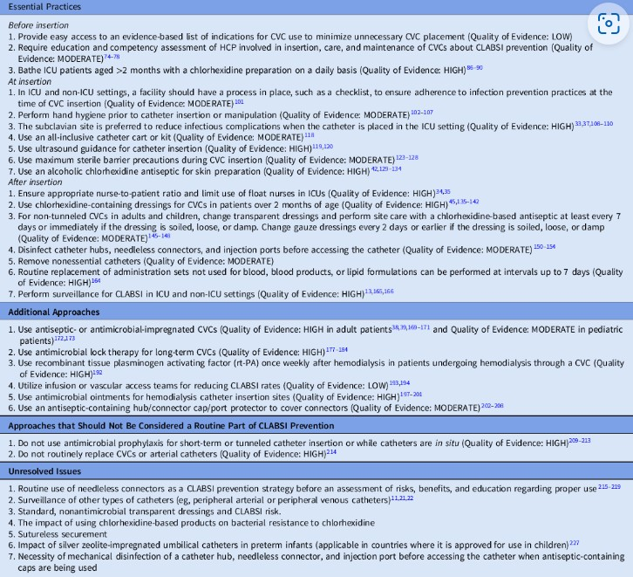
Summary of Recommendations to Prevent CLABSI – SHEA/IDSA/APIC 2022
Notes:
While this is not able to be read here, I urge you to go to the link and print yourself a copy!

Slide 41
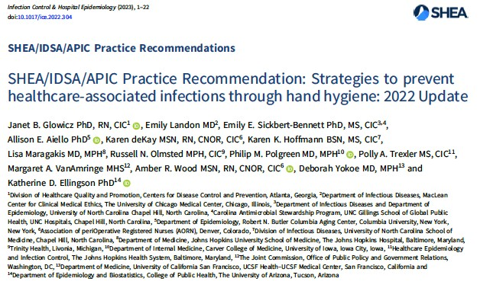
SHEA/IDSA/APIC PR – Hand Hygiene - 2023
SHEA/IDSA/APIC Practice Recommendation – Strategies to prevent health care- associated infections through hand hygiene: 2022 Update¹⁴ includes:
Promote the maintenance of healthy hand skin and fingernails
ABHR
4 Moments
Fingernail care
e.g., HCW who interact with sterile field during surgical procedure: should
not wear fingernail polish or gel shellac
ABHR dispenser location & number e.g., In private room, consider 2 ABHS dispensers the minimum threshold
(hallway and patient room)
Notes:
These are also part of IPAC Canada’s Hand Hygiene Practice Recommendations Terminology: Essential Practices and Special Approaches
Fingernail care includes length, natural, polish at IPAC program discretion – but not scrubbed/interact with sterile field

Slide 42
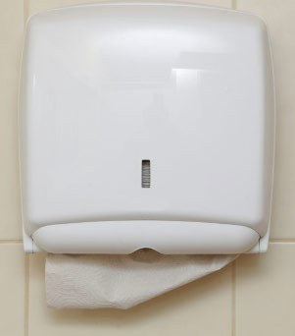
SHEA/IDSA/APIC PR – HH cont’d
Appropriate glove use – training – no routine double gloving – HH before donning - time
Reduce environmental contamination from sinks & drains
Single use towels, not air dryers in clinical areas
Monitor adherence to HH including observational audits with feedback
At least 15 seconds rubbing
Image sources: Vitalacy and Nursing Times

Slide 43
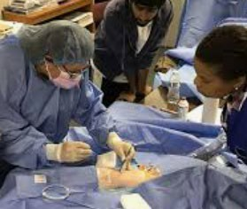
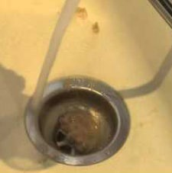
SHEA/IDSA/APIC - HH – Additional Approaches
SHEA/IDSA/APIC - HH – Additional Approaches
Educating HCP using a structured approach (e.g., 4 Moments) for handwashing or hand sanitizing & evaluate technique
Consider disinfection of sink drains against biofilms
For C. difficile and norovirus, in addition to contact precautions, encourage hand washing with soap and water after care
Educating HCP using a structured approach (e.g., 4 Moments) for handwashing or hand sanitizing & evaluate technique
Consider disinfection of sink drains against biofilms
For C. difficile and norovirus, in addition to contact precautions, encourage hand washing with soap and water after care
Image sources: Infusion Therapy Institute | IV Training certification | PICC line insertion (infusioninstitute.com); Drain Clean – YouTube; healthline.com
Image sources: Infusion Therapy Institute | IV Training certification | PICC line insertion (infusioninstitute.com); Drain Clean – YouTube; healthline.com
Notes:
Don’t feed the drain!

Slide 44
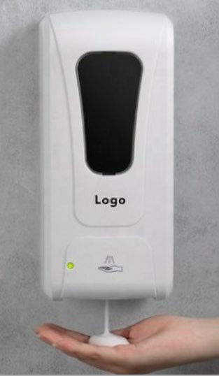
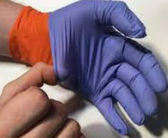
SHEA/IDSA/APIC - HH – Don’ts
Do NOT
Supply individual pocket-sized ABHS in lieu of accessible wall-mounted dispensers
Refill or “top-off” soap, moisturizer, or ABHS dispensers intended for single use
Use antimicrobial soaps formulated with triclosan
Routinely double-glove except when specifically recommended for certain job roles (e.g., OR scrub) or certain high-consequence pathogens (e.g., Ebola)
Routinely disinfect gloves during care except when specifically recommended for certain high-consequence pathogens
Remove access to ABHS for HCP responding to organisms (e.g., C. difficile,
norovirus)
Attempt to remediate potential biofilms in sink drains with
unregistered disinfectants (EPA, Health Canada)
Image sources: whitedogpromos.com; YourGloveSource.com; eBay
Notes:
Unresolved: HCP use of alcohol-impregnated hand wipes is unresolved due to the lack of noninferiority data

Slide 45
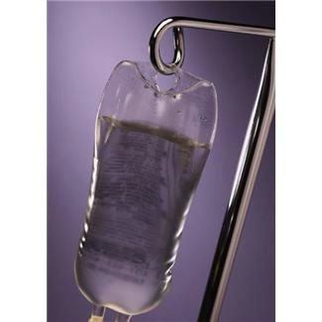
Recommended Frequencies - updated
MMWR Vol. 51/No. RR-10 Appendix B - Erratum: Vol. 51, No. RR-10 (cdc.gov)
**2017: CHG impregnated dressings for >18 yr.
Image source: Microsoft Office Clipart
Catheter | Line Change | Dressing Change | Set Change | Hang Time
Peripheral IV | Adult: No more frequently than 72-96 hr. Emergent: within 48 hr. Paeds: PRN | Adults: When replace catheter When damp, loose, soiled When bulky to inspect daily | Tubing & add-ons min. 72 96 hr. and at least q7 days* & PRN Bloods or lipids 24 hr. Intermittent – no recs. Propofol: 6-12 hr (MIFUs) | No recs. Lipid containing: in 24 hr. Lipids in 12 hr. Blood in 4 hr.
Midline | No rec. | As above | As above | As above
Peripheral Art. Line | Adult: Not routine Paeds: No rec. Transducers & flush at 24 96 hr. | As above | Tubing with transducers at 72 96 hr. | As above
CVC | Not routine | Gauze: q2 days** Transparent: q7 days on short-term & as above | Tubing & add-ons min. 72 96 hr. and at least q 7 days Bloods & lipids in 24 hr. | No recs. Lipid containing in 24 hr.
PA catheter | Not routine | As above | As above | As above
PICC Line | Not routine | As above | As above | As above
Notes:
Replace administration sets no more frequently than q 96 hr. and up to 7 days – also transducers Replace tubing for blood, lipids in 24 hr.
Use aseptic technique to enter system
Also: Guidelines for the Prevention of Intravascular Catheter-related Infections – O’Grady et al – 2011: Guidelines for the Prevention of Intravascular Catheter-related Infections - PMC (nih.gov) Recommendation Update [July 2017]
Catheter Site Dressing Regimens have been superseded. For patients aged 18 years and older:
Chlorhexidine-impregnated dressings with an FDA-cleared label that specifies a clinical indication for reducing catheter-related bloodstream infection (CRBSI) or catheter-associated bloodstream infection (CABSI) are recommended to protect the insertion site of short-term, non-tunneled central venous catheters. (Category IA). (See Section 5.0 Implementation Considerations for Patients Aged 18 Years and Older). For more information, see the Chlorhexidine-Impregnated Dressing Recommendation Edits and Changes [February 2017] BSI | Guidelines Library | Infection Control | CDC

Slide 46
Tracking CLABSI/PLABSI
SHEA/IDSA/APIC 2022:
Perform surveillance for CLABSI in ICU and non-ICU settings
Measure unit-specific incidence of CLABSI and report the data on a regular basis to the units, physician and nursing leadership, and hospital administrators
Compare CLABSI incidence to historical data for individual units and to national rates (e.g., NHSN, CNISP).
Audit surveillance as necessary to minimize variation in inter- observer reliability

Slide 47
Surveillance Rate Measurements
Outcome Surveillance:
Central line catheter related bloodstream infection rate per 1000 central line-days
Total no. of CR-BSI cases x 1000 No. of catheter days
Process Surveillance:
Checklist Compliance
No. of ALL Elements of Checklist
No. with CVCs on the day of the sample
Notes:
Do not routinely culture tips Monitor sites visibly or by palpation
Encourage reporting by patients and record all info With Infection Control:
Benchmark against CCDR rates Benchmark against yourself

Slide 48
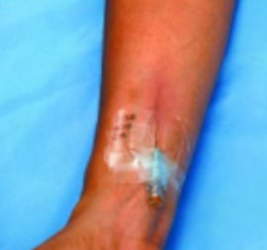
Auditing and Benchmarking
Do not routinely culture tips
Monitor sites visibly or by palpation
Encourage reporting by patients and record all info
With Infection Control:
Benchmark against CCDR rates
Benchmark against yourself
Complications of Peripheral I.V. Therapy | NursingCenter

Slide 49
Auditing of practices
Insertion
HH before insertion
Maximum barrier precautions
CHG for skin asepsis
Optimal catheter selection (avoid femoral, favor subclavian)
Adequate dressing
The auditor should not be the inserter
Target 95%

Slide 50
Auditing of practices
Maintenance
Catheter necessity assessed daily
Aseptic access to the catheter lumen
Dressing is intact
Tubings are changed according to protocol
Target 95%

Slide 51
Plan-Do-Study-Act (PDSA) Cycle
Scientific method based on action-oriented learning
Advocated in real work settings:
Plan a test
Try it
Observe results
Act on learning
Notes:
PDSA or PDCA – with C for Check in LEAN terminology. Quality Improvement Cycle - Read slide.

Slide 52
Sample Forms
From IHI
Insertion Checklist

Slide 53
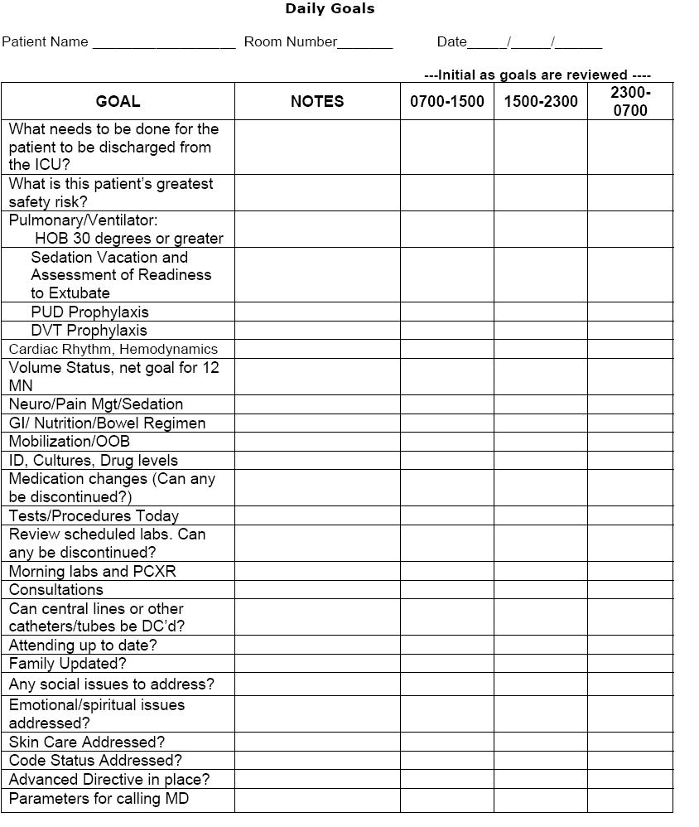
Daily Goals ICU
From The Johns Hopkins Hospital, 2005

Slide 54
Peripheral Intravenous Line Infections
Up to 90% of hospital inpatients require PIV insertion
80% to 90% of all vascular catheters are PIV
Data is limited - not required to be reported
Staph aureus infections metastasize with greater mortality
One study found 70% from old IV sites
Guidelines: hand hygiene, 2% chlorhexidine in 70% alcohol skin prep, disinfection of needleless connectors and consideration of an insertion bundle
Innovative QI approaches have included the use of LEAN strategies for one PIV per patient visit
Austin, Sullivan, Whittier, Lowy & Uhlemann (2016): Peripheral Intravenous Catheter Placement Is an Underrecognized Source of Staphylococcus aureus Bloodstream Infection | Open Forum Infectious Diseases | Oxford Academic (oup.com)
Zhang, Cao, Marsh, et al, (2016): Infection risks associated with peripheral vascular catheters (sagepub.com)
Mermel. (2017): Short-term Peripheral Venous Catheter–Related Bloodstream Infections: A Systematic Review | Clinical Infectious Diseases | Oxford Academic (oup.com)
Guenezan, Marjanovic, Drugeon, et al. (2021): Chlorhexidine plus alcohol versus povidone iodine plus alcohol, combined or not with innovative devices, for prevention of short-term peripheral venous catheter infection and failure (CLEAN 3 study) - The Lancet Infectious Diseases
Gorski, Hadaway, Hagle, et al. (2021): Infusion Therapy Standards of Practice, 8th Edition : Journal of Infusion Nursing (lww.com)
Steere, Ficara, Davis , Moureau. (2019). Reaching One Peripheral Intravenous Catheter (PIVC) Per Patient Visit With Lean Multimodal Strategy: the PIV5Rights™ Bundle | Journal of the Association for Vascular Access (allenpress.com)
Notes:
Although the risk of PVC-related BSI is classically lower (fewer than 0.5 episodes per 1000 catheter-days) than with other intravascular devices (up to 2.7 episodes per 1000 catheter-days for central venous catheters (CVCs)), the total number of PVCs used worldwide means that the total number of PVC-related BSIs is close to, or even greater than, the number of CVC-related BSIs

Slide 55
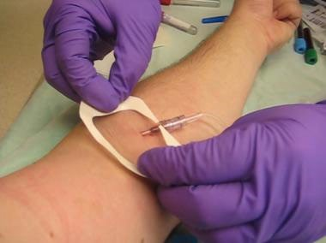
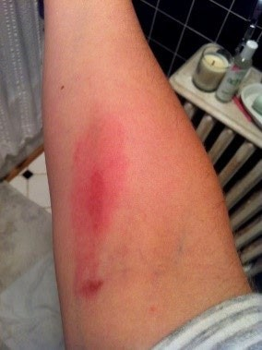
Risk factors
Increasing risk
Antecubital fossa insertion
Proximal forearm insertion
Presence of phlebitis signs
Duration more than 4 days
Insertion in the ED
Male
Images source: France Paquet

Slide 56
Central venous catheter-related infection – back to basics - Mervyn Mer (2022)
Mnemonic – CRBSI – to remember and reinforce core elements of CVC care and limit infective-related sequelae:
C - chlorhexidine-alcohol skin antisepsis; caps (port protectors)
R - remove all unnecessary lines; remain in situ for up to 14 days safely if required with appropriate infection control measures (longer durations may be possible but sound evidence exists for up to 14 days)
B - barrier precautions to the maximum (sterile gloves, mask, gown, cap, large drape)
S - site selection (site probably makes very little difference if adequate infection control measures)
- seal and securement: newer chlorhexidine containing dressings if possible
I - impeccable infection control (preparation, insertion, maintenance)
importance of hand hygiene at all times
inspect daily (and record)
“Adherence to these basic measures will go a long way in helping to achieve the ultimate goal of zero catheter-related infections.”
Notes:
How can we make doing the right thing easier?

Slide 57
Summary
Intravascular lines are extensively used in health care and are life lines for patients
Catheter-related infections and CLABSIs are a serious concern, too commonly causing illness and death, and high costs to both patients/residents and health care
Risk factors include patient, catheter, and organism factors
Monitoring and surveillance are vital for rapid detection and mitigation/treatment and prevention of infections
Line infections can be prevented by relatively simple strategies such as hand hygiene and the use of checklists and essential practices

Slide 58
References
Gaynes, R., & Jacob, J. T. (2019). Intravascular catheter-related infection: Epidemiology, pathogenesis, and microbiology. U: UpToDate, Post TW ur. UpToDate [Internet]. Waltham, MA: UpToDate. Available from https://www.uptodate.com/contents/intravascular-catheter-related-infection-epidemiology-pathogenesis- and-microbiology
Haddadin, Y., Annamaraju, P., & Regunath, H. (2017). Central line associated blood stream infections. Available from https://europepmc.org/article/nbk/nbk430891#free-full-text
Goto, M., & Al-Hasan, M. N. (2013). Overall burden of bloodstream infection and nosocomial bloodstream infection in North America and Europe. Clinical Microbiology and Infection, 19(6), 501-509. Available from https://www.sciencedirect.com/science/article/pii/S1198743X1461507X
Redstone, C. S., Zadeh, M., Wilson, M. A., McLachlan, S., Chen, D., Sinno, M., ... & Taher, A. (2023). A Quality Improvement Initiative to Decrease Central Line–Associated Bloodstream Infections During the COVID-19 Pandemic: A “Zero Harm” Approach. Journal of Patient Safety, 19(3), 173. Available from https://www.ncbi.nlm.nih.gov/pmc/articles/PMC10044591
Canadian Nosocomial Infection Surveillance Program. (2020). Device-associated infections in Canadian acute- care hospitals from 2009 to 2018. Canada Communicable Disease Report, 46(11/12). Available from https://www.proquest.com/docview/2563801222?pq-origsite=gscholar&fromopenview=true
Fakih, M. G., Bufalino, A., Sturm, L., Huang, R. H., Ottenbacher, A., Saake, K., ... & Cacchione, J. (2022). Coronavirus disease 2019 (COVID-19) pandemic, central-line–associated bloodstream infection (CLABSI), and catheter-associated urinary tract infection (CAUTI): the urgent need to refocus on hardwiring prevention efforts. Infection Control & Hospital Epidemiology, 43(1), 26-31. Available from https://www.cambridge.org/core/journals/infection-control-and-hospital-epidemiology/article/covid19- pandemic-clabsi-and-cauti-the-urgent-need-to-refocus-on-hardwiring-prevention- efforts/AB369E693CE1532E91721345384ACAE6

Slide 59
References cont’d
Canadian Nosocomial Infection Surveillance Program (CNISP). (2022). Device and surgical procedure-related infections in Canadian acute care hospitals from 2011 to 2020. Canada communicable disease report= Releve des maladies transmissibles au Canada, 48(7-8), 325-339. Available from https://pubmed.ncbi.nlm.nih.gov/37342537/
Weiner, L. M., Webb, A. K., Limbago, B., Dudeck, M. A., Patel, J., Kallen, A. J., ... & Sievert, D. M. (2016). Antimicrobial-resistant pathogens associated with healthcare-associated infections: summary of data reported to the National Healthcare Safety Network at the Centers for Disease Control and Prevention, 2011–
2014. infection control & hospital epidemiology, 37(11), 1288-1301. Available from
https://www.cambridge.org/core/journals/infection-control-and-hospital- epidemiology/article/antimicrobialresistant-pathogens-associated-with-healthcareassociated-infections- summary-of-data-reported-to-the-national-healthcare-safety-network-at-the-centers-for-disease-control-and- prevention-20112014/599EB379C92AF1B053E065DC9F809323
Endimiani, A., Tamborini, A., Luzzaro, F., Lombardi, G., & Toniolo, A. (2003). A two-year analysis of risk factors and outcome in patients with bloodstream infection. Japanese journal of infectious diseases, 56(1), 1-7. Available from https://pubmed.ncbi.nlm.nih.gov/12711818/
Buetti, N., Marschall, J., Drees, M., Fakih, M. G., Hadaway, L., Maragakis, L. L., ... & Mermel, L. A. (2022). Strategies to prevent central line-associated bloodstream infections in acute-care hospitals: 2022 Update. Infection Control & Hospital Epidemiology, 43(5), 553-569. Available from
https://www.cambridge.org/core/journals/infection-control-and-hospital-epidemiology/article/strategies-to-
prevent-central-lineassociated-bloodstream-infections-in-acutecare-hospitals-2022- update/01DC7C8BBEA1F496BC20C6E0EF634E3D

Slide 60
References cont’d
Fraenkel, D. J., Rickard, C., & Lipman, J. (2000). Can we achieve consensus on central venous catheter-related infections?. Anaesthesia and intensive care, 28(5), 475-490. Available from Fraenkel, D. J., Rickard, C., & Lipman,
J. (2000). Can we achieve consensus on central venous catheter-related infections?. Anaesthesia and intensive
care, 28(5), 475-490. Available from https://pubmed.ncbi.nlm.nih.gov/11094662/
Hall, K. K., & Lyman, J. A. (2006). Updated review of blood culture contamination. Clinical microbiology reviews, 19(4), 788-802. Available from https://journals.asm.org/doi/full/10.1128/cmr.00062-05
Hendler, C. B. (2022). Getting back to basics with preventing CLABSI. Wolters Kluwer. Health, June 01, 2022. Available from https://www.wolterskluwer.com/en/expert-insights/getting-back-to-basics-with-preventing- clabsi
Glowicz, J. B., Landon, E., Sickbert-Bennett, E. E., Aiello, A. E., Dekay, K., Hoffmann, K. K., ... & Ellingson, K. D. (2023). SHEA/IDSA/APIC Practice Recommendation: Strategies to prevent healthcare-associated infections through hand hygiene: 2022 Update. Infection Control & Hospital Epidemiology, 44(3), 355-376. Available from https://www.cambridge.org/core/journals/infection-control-and-hospital-epidemiology/article/sheaidsaapic- practice-recommendation-strategies-to-prevent-healthcareassociated-infections-through-hand-hygiene-2022- update/FCD05235C79DC57F0E7F54D7EC314C2C
Austin, E. D., Sullivan, S. B., Whittier, S., Lowy, F. D., & Uhlemann, A. C. (2016, April). Peripheral intravenous catheter placement is an underrecognized source of Staphylococcus aureus bloodstream infection. In Open forum infectious diseases (Vol. 3, No. 2, p. ofw072). Oxford University Press. Available from https://academic.oup.com/ofid/article/3/2/ofw072/2399348?login=false

Slide 61
References cont’d
Zhang, L., Cao, S., Marsh, N., Ray-Barruel, G., Flynn, J., Larsen, E., & Rickard, C. M. (2016). Infection risks associated with peripheral vascular catheters. Journal of infection prevention, 17(5), 207-213. Available from https://journals.sagepub.com/doi/abs/10.1177/1757177416655472
Mermel, L. A. (2017). Short-term peripheral venous catheter–related bloodstream infections: a systematic review. Clinical Infectious Diseases, 65(10), 1757-1762. Available from https://academic.oup.com/cid/article/65/10/1757/4079720
Guenezan, J., Marjanovic, N., Drugeon, B., Neill, R. O., Liuu, E., Roblot, F., ... & Mimoz, O. (2021). Chlorhexidine plus alcohol versus povidone iodine plus alcohol, combined or not with innovative devices, for prevention of short-term peripheral venous catheter infection and failure (CLEAN 3 study): an investigator-initiated, open-label, single centre, randomised-controlled, two-by-two factorial trial. The Lancet Infectious Diseases, 21(7), 1038-1048. Available from https://www.thelancet.com/journals/laninf/article/PIIS1473-3099(20)30738-6/fulltext
Gorski, L. A., Hadaway, L., Hagle, M. E., Broadhurst, D., Clare, S., Kleidon, T., ... & Alexander, M. (2021). Infusion therapy standards of practice. Journal of Infusion Nursing, 44(1S), S1-S224. Available from https://journals.lww.com/journalofinfusionnursing/Citation/2021/01001/Infusion_Therapy_Standards_of_Practice
,_8th.1.aspx?context=LatestArticles
Steere, L., Ficara, C., Davis, M., & Moureau, N. (2019). Reaching one peripheral intravenous catheter (PIVC) per patient visit with lean multimodal strategy: the PIV5Rights™ bundle. Journal of the Association for Vascular Access, 24(3), 31-43. Available from https://meridian.allenpress.com/java/article/24/3/31/436378/Reaching-One- Peripheral-Intravenous-Catheter-PIVC

Slide 62
Notes:
Questions received:
What solutions are recommended for IV site preparation if chlorhexidine preparations are not available? Povidone
Using ANTT when inserting an IV should be minimum expectation. How can we perform skin antisepsis and abide by ANTT if using a WIPE for cleaning the skin (thinking an applicator is safer?) Thank you so much for doing this much needed webinar to increase our awareness of infection risk with every IV start. HH, clean gloves, technique matters
Possibly discuss the types of central lines that are more infection resistant that other central lines and why healthcare providers would choose one over the other? Subclavian has lowest risk. Implanted lines have lower risk than
Are there any measures taken to evaluate the statistics related to infection caused by IVs? Yes - discussed
Ultrasound guided PIV insertion helps so much with DIVA (Difficult IV Access) patients in both inpatient and ambulatory setting. How important is it to use the ultrasound kit (US sleeve, sterile ultrasound gel, CHG + alcohol skin antiseptic)? Any study or recent data you can share? IPAC best practices include to follow MIFUs – and ANTT requires that no organisms are introduced via key parts to key sites!
Which microorganism is most associated to bloodstream infections? Skin organisms – Staph epidermis/coag neg staph
IV therapy in community sites such as a dental clinic – principles and practices must remain the same wherever the line is inserted (like reprocessing)
How to prevent bloodstream infections? Role of antibiotic impregnated iv canula in preventing Bloodstream infections – recommended in high-risk institutions (esp ICUs) and high-risk patients (repeated infections)
What antiseptic is considered best practice for CVAD line infection prevention? (i.e. CHG and if so which % vs. aqueous solutions) – 2% in 70% alcohol
Any advice on line maintenance to prevent CLABSIs? Keep site protected and system closed. CHG sponge at site
What is the evidence before or against different locking solutions such as EDTA – evidence looking good to salvage lines – 70%+ success in many studies
We have seen a dramatic increase in CLABSIs at our oncology site after day 8 of being in. We believe this is likely due to care and maintenance. WE have been looking for resources.
Look forward to hearing about IV bundle practice recommendation. Wondering if an environmental scan on if healthcare facilities/ regions are doing annual recertifications or leaving Central line care competencies up to the individual nurses to assess their own skills? I recommend annual review – it is a risk to the organization as well as the nurse – and the patient!

Slide 63
Blood Sampling from VAD - CVAA 2019
Perform risk-benefit analysis before routinely using VAD for blood sampling. Consider use of VAD for:
Pediatric patient
Adult with challenging access
Patient with bleeding disorder
Obtaining frequent blood tests
Patient with anxiety and fear of blood draws
Use direct VAD luer lock or syringe transfer device for blood sampling. Do not use needle to transfer blood into tube.
Do not apply pressure to plunger when using syringe transfer method (to avoid hemolysis). Maintain closed system by blood sampling through needle-free connector (exception: see Blood Cultures).
Do not draw blood sample from:
Access port on administration set (to avoid cross-contamination from solution and/or medication)
Lumen with continuous infusion that cannot be interrupted (e.g., critical medication, narcotic, inotrope).
Notes:
Which is best practice when drawing off a line with an extension (or needleless cap) directly luered to the central line - draw through the extension / cap (risk of blood in the cap/extension once done even with good flushing) or open the system and draw directly from the line? IS there an established best practice?
CLA-BSI pros and cons of drawing blood from central line, peripheral, or arterial lines – In ICUs, when art lines are in place for monitoring and blood gases, this may be the most expedient way to obtain specimens but it is not without risk. Peripheral sampling has the least risk of related infection.
What is the evidence before or against different locking solutions such as EDTA
We have seen a dramatic increase in CLABSIs at our oncology site after day 8 of being in. We believe this is likely due to care and maintenance. WE have been looking for resources.
Look forward to hearing about IV bundle practice recommendation. Wondering if an environmental scan on if healthcare facilities/ regions are doing annual recertifications or leaving Central line care competencies up to the individual nurses to assess their own skills? I recommend annual review – it is a risk to the organization as well as the nurse – and the patient!

Slide 64
Other Questions Received
Use of IV therapy in Personal Service Settings by non-regulated health providers
Regulated Act
Training and delegation from Registered healthcare professional (e.g., physician, RN)
Consider liability
Reducing incidences of infection in CVADs
Hope we have addressed that
Chlorhexidine sticks or alcohol wipes, (or other?) - What is preferred for clean/disinfect prior to accessing established line?
Wipes or applicators containing chlorhexidine and alcohol are best for any sites where something in remaining insitu (e.g., line, dressing)
Alcohol alone is fine for blood sampling

Slide 65
Contact:
Madeleine Ashcroft
THP Community Outreach IPAC Hub
Madeleine.Ashcroft@thp.ca

